Slide 1
Computer Graphics EG678EX
2-D Algorithms

Slide 2
Points and Lines
Points
Plotted by converting co-ordinate position to appropriate operations for the output device (e.g: in CRT monitor, the electron beam is turned on to illuminate the screen phosphor at the selected location.)
Line
Plotted by calculating intermediate positions along the line path between two specified endpoint positions.
Screen locations are referenced with integer values, so plotted positions may only approximate actual line positions between two specified endpoints 🡪 “the jaggies”. E.g: position (10.48,20.51) 🡪 (10,21).

Slide 3

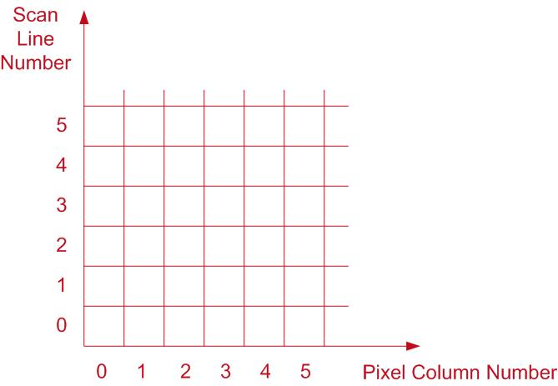
Jaggies
Pixel position: referenced by scan line number and column number

Slide 4
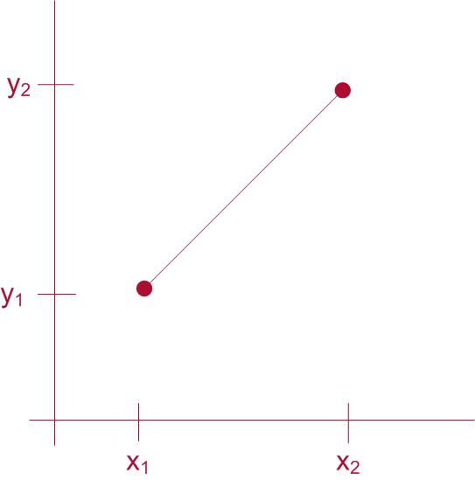
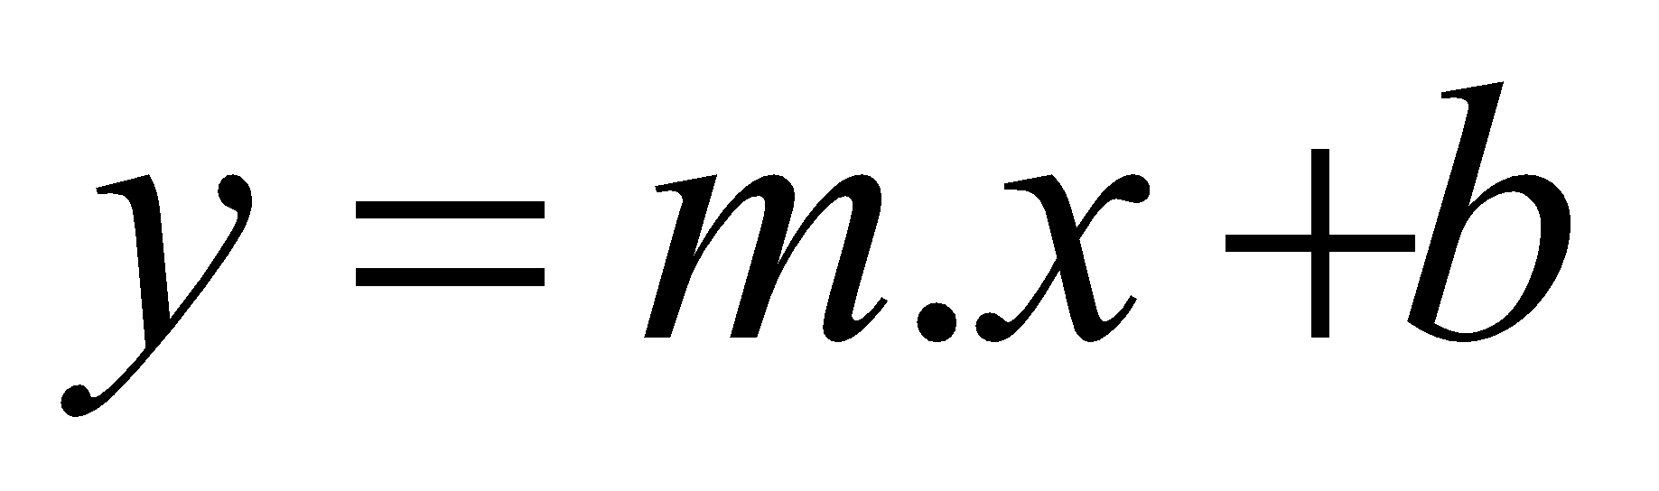
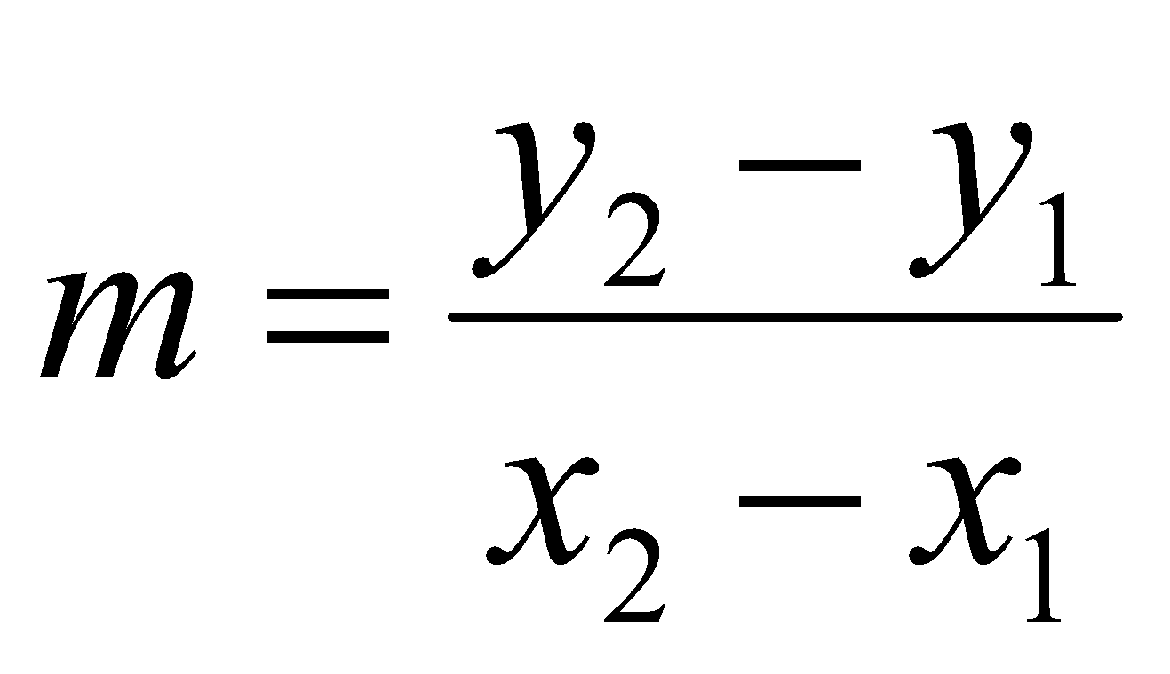
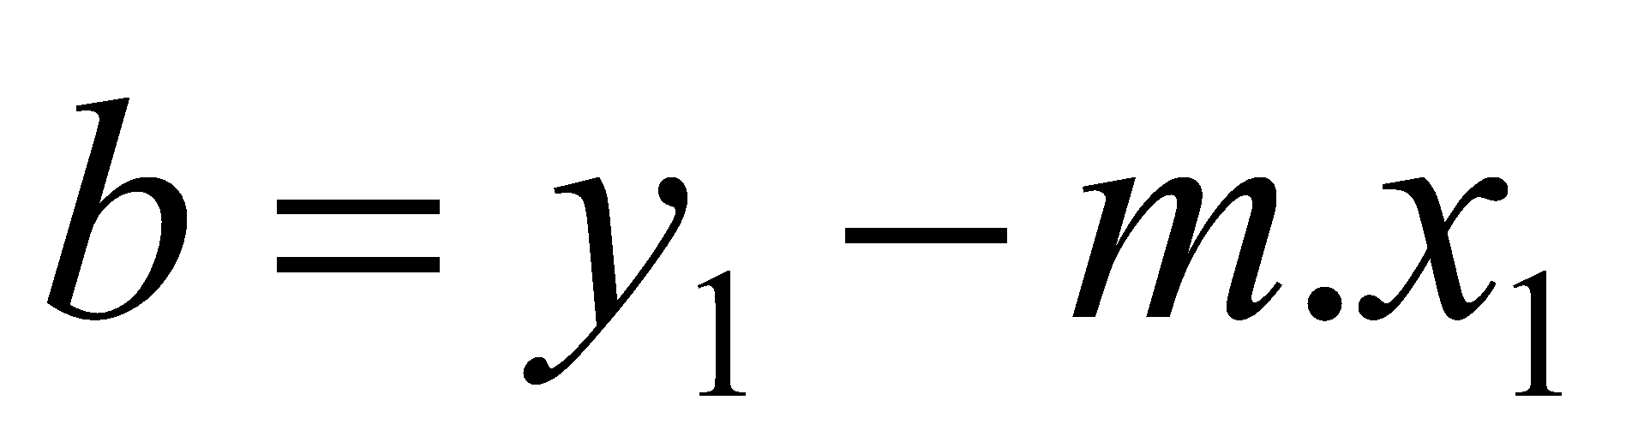
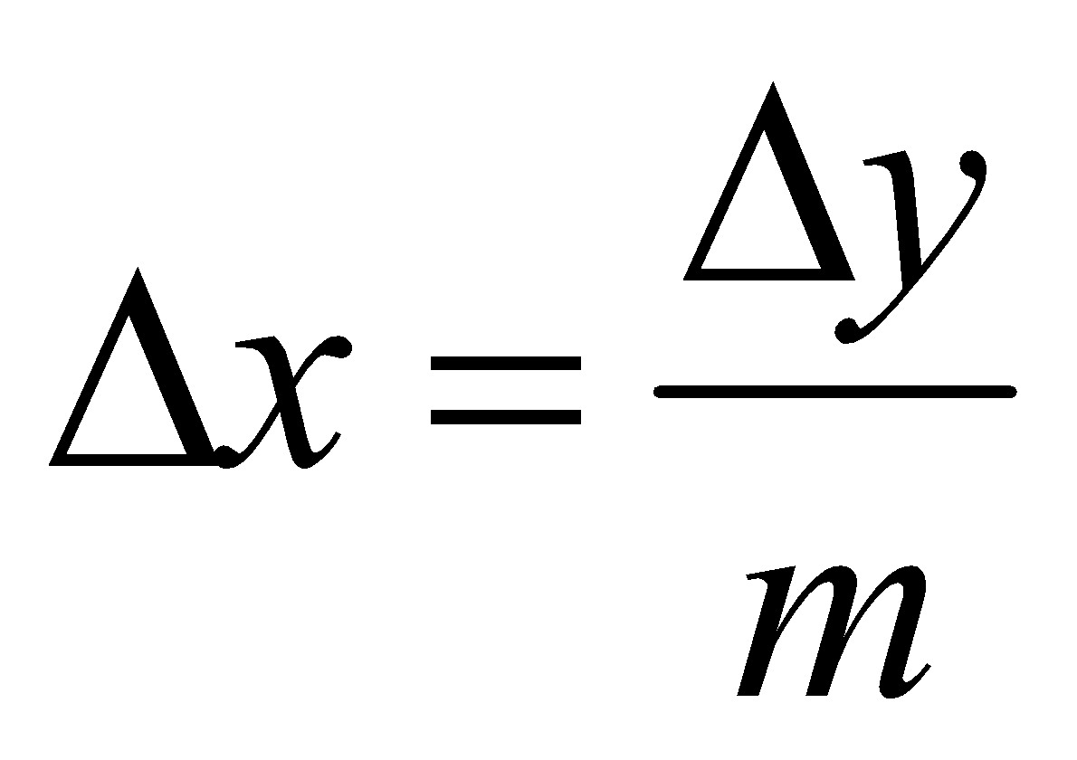
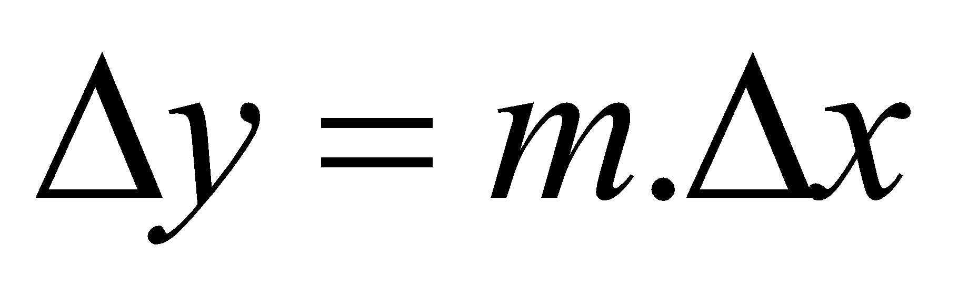
Line Drawing Algorithms
Slope-Intercept Equation
Slope
Intercept
Interval Calculation

Slide 5
Analog System
|m| <1
Set Δx proportional to horizontal deflection voltage. Then
|m|>1
Set Δy set proportional to vertical deflection voltage. Then
|m|=1
Δx = Δy 🡺 horizontal and vertical deflection voltages are equal

Slide 6
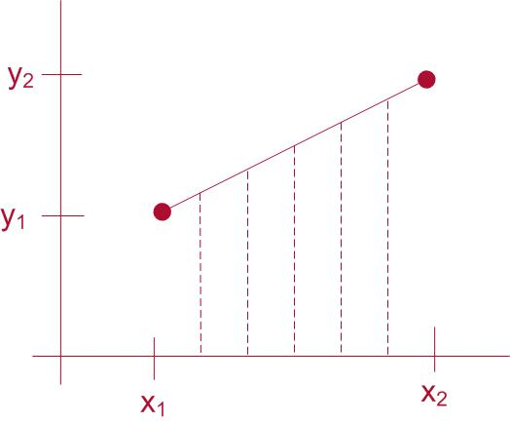
Digital System
Sample a line at discrete positions and determine nearest pixel to the line at each sampled position

Slide 7
DDA Algorithm
🡪 Digital Differential Analyzer
Sample the line at unit intervals in one coordinate
Determine the corresponding integer values nearest the line path in another co-ordinate

Slide 8
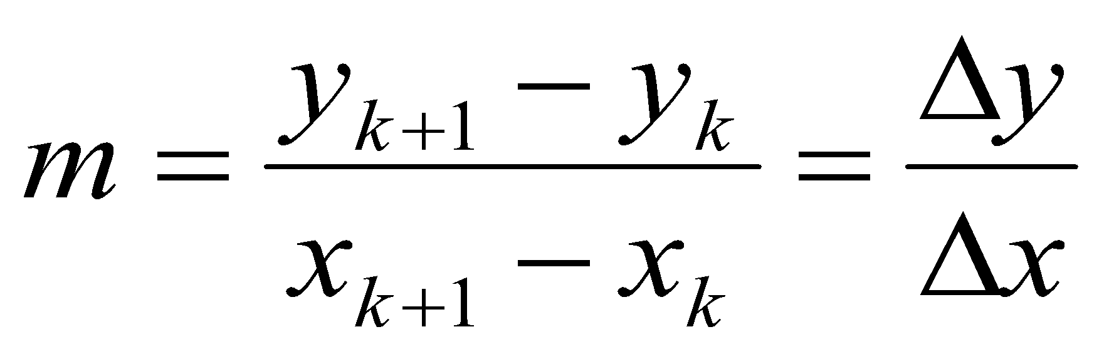
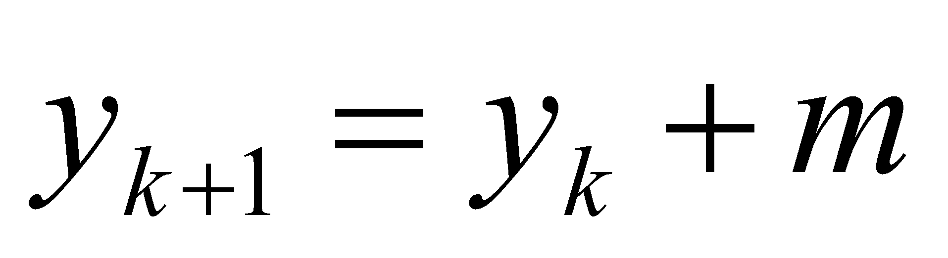
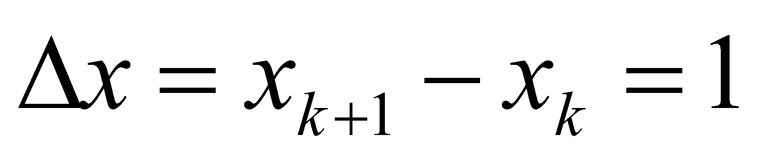
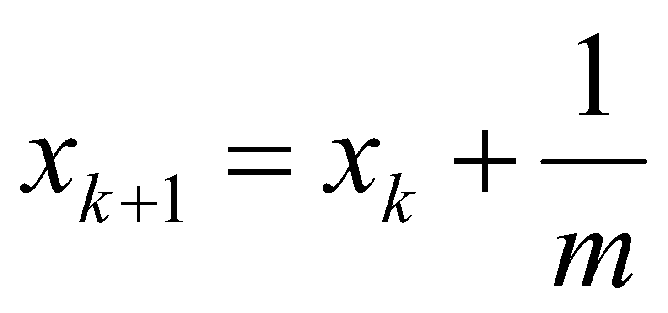
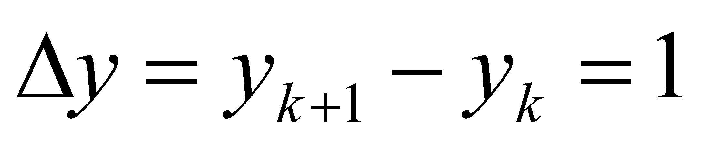
DDA Algorithm (left to right)
Slope
For |m|<1 (|Δy|< |Δx|)
Sample line at unit interval in x co-ordinate
For |m|>1 (|Δy|> |Δx|)
Sample line at unit interval in y co-ordinate

Slide 9
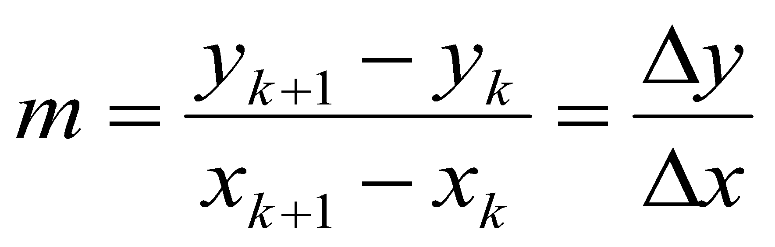
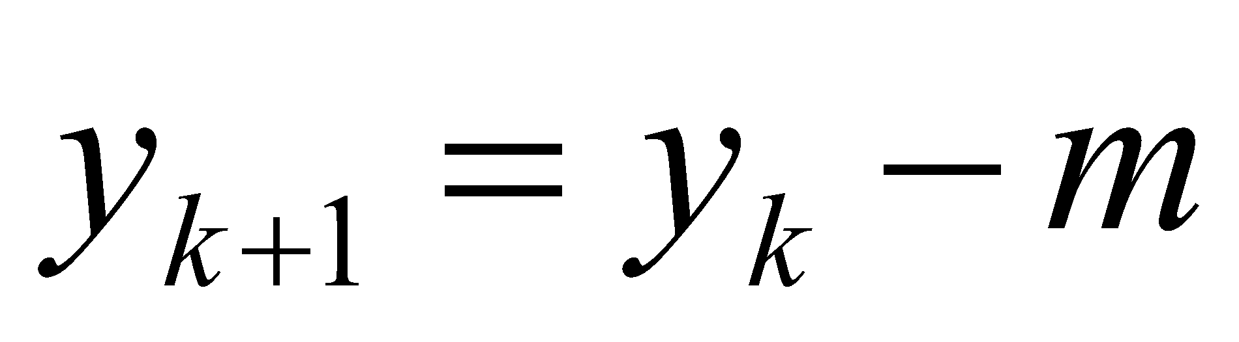
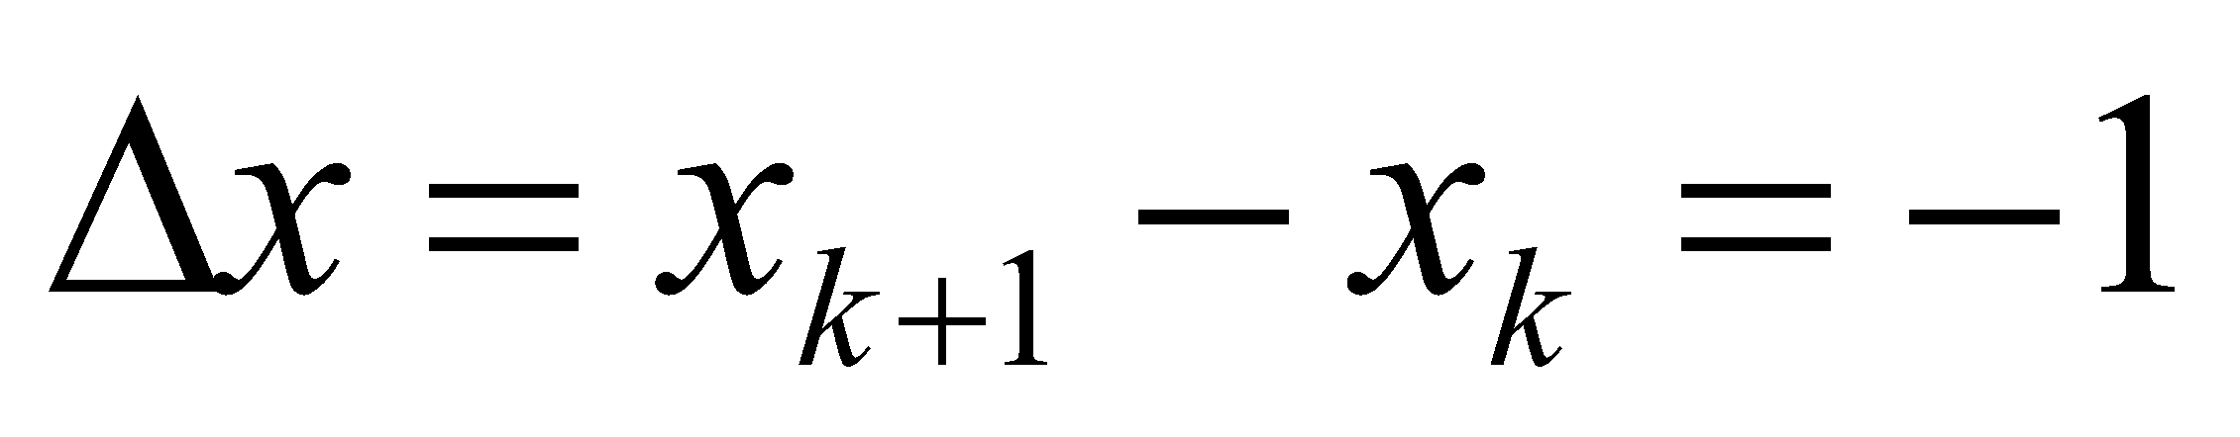
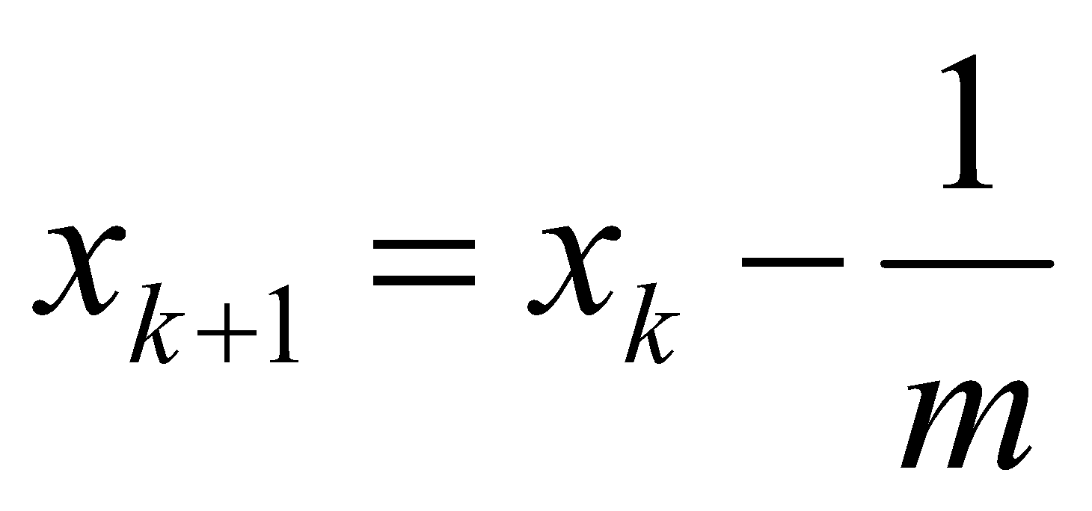
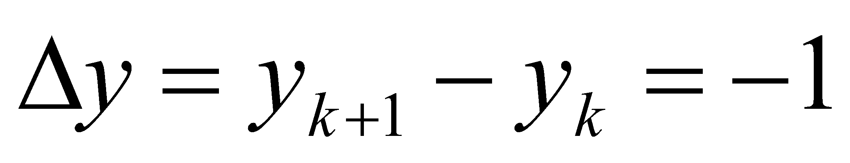
DDA Algorithm (right to left)
Slope
For |m|<1 (|Δy|< |Δx|)
Sample line at unit interval in x co-ordinate
For |m|>1 (|Δy|> |Δx|)
Sample line at unit interval in y co-ordinate

Slide 10
DDA Algorithm
Input the two line endpoints and store the left endpoint in (x₀,y₀)
Plot first point (x₀,y₀)
Calculate constants Δx, Δy
If |Δx| > |Δy| steps = |Δx| else steps = |Δy|
Calculate XInc = |Δx| / steps and YInc = |Δy| / steps
At each x_{k} along the line, starting at k=0, Plot the next pixel at (xk + XInc, yk + YInc)
Repeat step 6 steps times

Slide 11
Pseudo Code
Void lineDDA(int xa, int ya, int xb, int yb)
{
int dx = xb – xa, dy = yb – ya, steps, k;
float xIncrement, yIncrement, x = xa, y = ya;
if( abs (dx) > abs (dy) ) steps = abs (dx);
else steps = abs (dy);
xIncrement = dx / (float) steps;
yIncrement = dy / (float) steps;
setPixel (ROUND (x), ROUND (y));
for (k=0; k<steps; k++){
x += xIncrement;
y += yIncrement;
setPixel (ROUND(x), ROUND(y));
}
}

Slide 12
DDA Algorithm
How about problem and performance ?
Assignment:
What's the performance problem in above pseudo code ?
How DDA performance can be improved ?

